Slide 1
Texting with Frequency Encoding
Brian McRee
Jacob Sanchez
Jobin Thomas
Stephanie Bello
November 4, 2013

Slide 2
Project Guidelines
The minimum number of characters for the text message is 100. ’0’ should be encoded as 20 MHz and ’1’ should be encoded as 10 MHz sinusoid. The bit length is 1 ms. Develop and implement algorithms in MATLAB for the CODEC part of the communication system (one at the transmitter and another one at the receiver); they include components for encoding/decoding text messages. Your program shall prompt the user for a text message (which is terminated with a return), encode the message, store the encoded message as the frequency encoded signal at transmitter end, read back the stored and encoded signal at receiver end, decode the text from the encoded message and print the message on the receiver screen.

Slide 3
theory

Slide 4


Convolution/Correlation
Convolution
Correlation
Convolution is a mathematical operation on two functions (f and g), producing a third function that is typically viewed as a modified version of one of the original functions, giving the area overlap between the two functions as a function of the amount that one of the original functions is translated.
$$\left(f∗g\right)\left(t\right)= \int_{−∞}^{∞}{f\left(T\right)g\left(t−T\right)dT}= \int_{−∞}^{∞}{f\left(t−T\right)g\left(T\right)dT}$$
Correlation is the degree of association between two random variables. The correlation between the graphs of two data sets is the degree to which they resemble each other.
$$ρX,Y=corr\left(X,Y\right)= \frac{cov(X,Y)}{σXσY}= \frac{E[\left(X−μX\right)\left(Y−μY\right)]}{σXσY}$$

Slide 5
Method

Slide 6
Encoder Flowchart

Slide 7
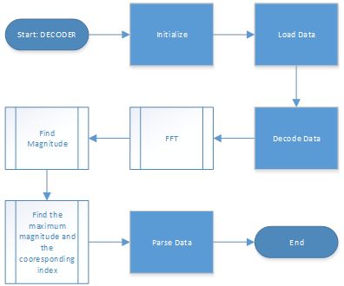
Decoder flowchart

Slide 8
Encoder

Slide 9
decoder

Slide 10

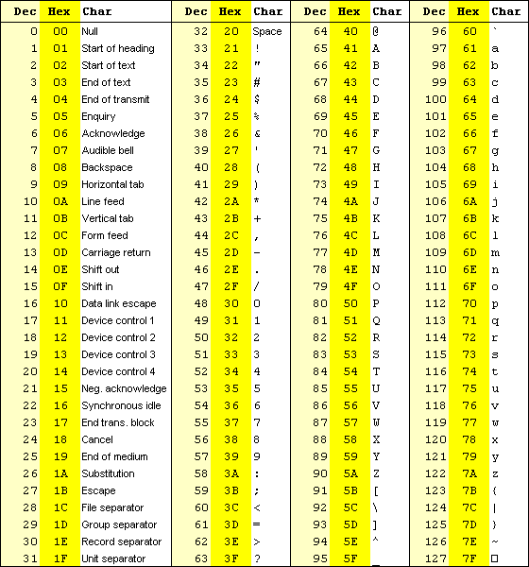
Dec numb. from message
ASCII Table

Slide 11
